Slide 1

Sentiment Analysis
Submitted by : Sudipta Mitra
Roll No. : 23440523027
Bachelor of Science in Data Science
Paper Code: FYBMS581
NSHM Knowledge Campus, Kolkata
.

Slide 2
Table of contents
Introduction and Objective
Sentiment Analysis Workflow
Model Selection
Model Evaluation
Limitations and Future Work
Conclusion

Slide 3


Introduction and Objective
Sentiment Analysis is a part of Natural Language Processing (NLP)
Used to analyze opinions in text data.
Manual analysis is slow and inefficient.
Machine Learning enables automatic sentiment detection.
This project focuses on IMDb movie reviews.
Total reviews: 50,000
Preprocess raw text data.
Selected balanced subset: 5,000 reviews
Sentiment labels: Positive and Negative

Slide 4
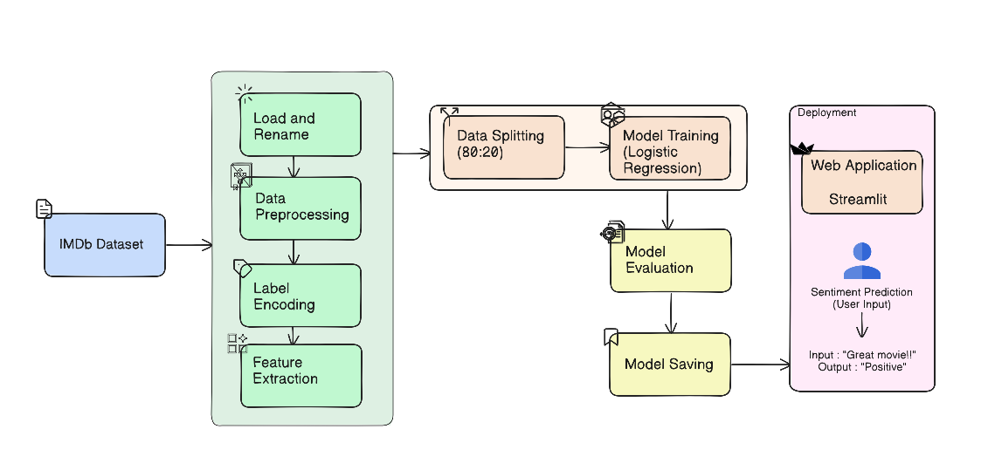
Sentiment Analysis Workflow

Slide 5
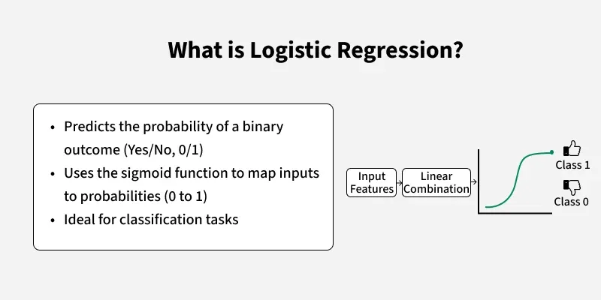
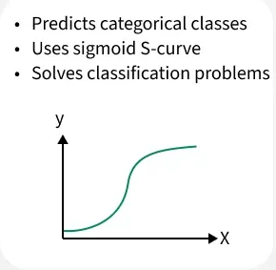
Model Selection

Slide 6
Model Evaluation
Accuracy | Precision | Recall | F1-Score
85.10 | 81.89 | 89.68 | 85.60
The model achieved an accuracy of 85.10%, indicating effective overall classification of movie reviews. With a precision of 81.89%, recall of 89.68%, and an F1-score of 85.60%, the results show that the model is highly capable of correctly identifying positive and negative sentiments.
Accuracy: How many reviews the model predicted correctly overall.
Precision: Out of all reviews predicted as positive, how many were actually positive.
Recall: Out of all actual positive reviews, how many the model correctly found.
F1-Score: A balanced measure that combines precision and recall.

Slide 7
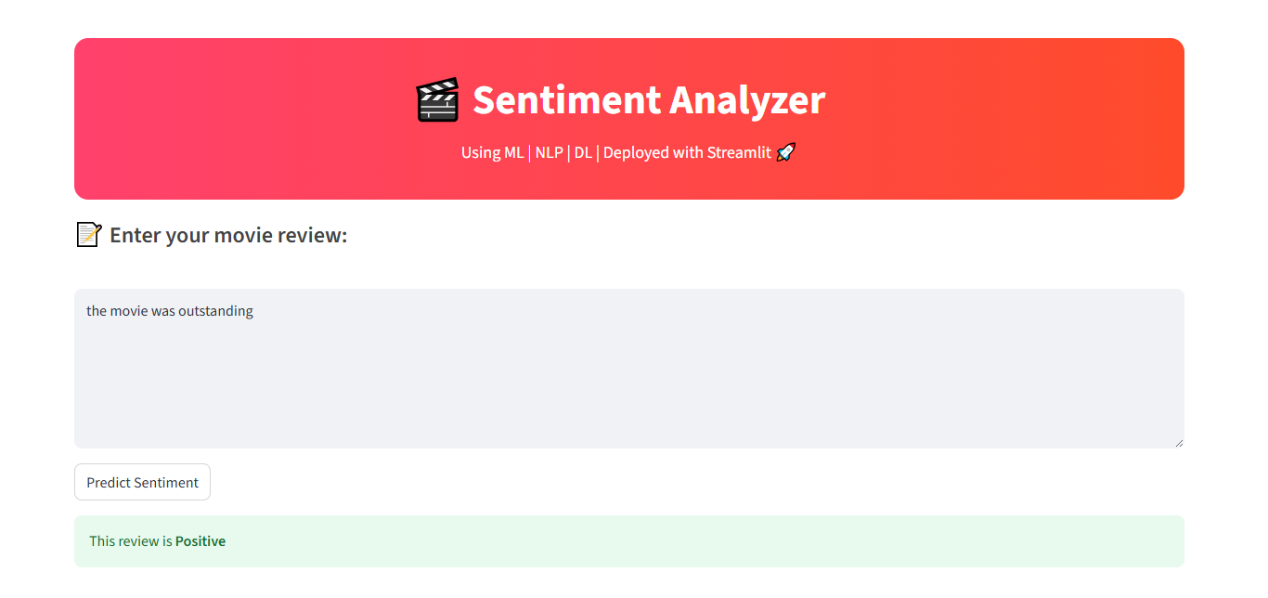

Slide 8
Limitations
Future Work
Limitations and Future Work
The model classifies only positive and negative sentiments.
It may not understand sarcasm or complex language.
Performance depends on the quality of text preprocessing.
Logistic Regression may miss contextual meaning of words.
Use advanced models like LSTM or BERT for better accuracy.
Add neutral and multi-class sentiment detection.
Support multiple languages.
Include real-time sentiment analysis with live data sources.

Slide 9
Conclusion
This project successfully demonstrates the development of a sentiment analysis system that can classify text as positive, negative, or neutral. Although it primarily focuses on text classification using TF-IDF and Logistic Regression, it effectively shows how machine learning can be applied to understand human emotions in written content. The use of NLTK for preprocessing and Joblib for model saving makes the system efficient and easy to maintain. Furthermore, the Streamlit web application makes the model accessible to anyone, allowing users to input text and instantly see the predicted sentiment. Overall, while the project is mainly focused on building a sentiment analysis system , it can be used in real-world situations like product reviews, customer feedback, and social media monitoring, making it a useful tool for both businesses and individuals.

Slide 10


